Slide 1
Train the trainers
Modern teaching methods

Slide 2
Overview
Implementation of EWF guidelines into practical training
Implementation of Welding Simulator during MIG/MAG training
Distance learning and ZOOM lectures
Distance learning of theoretical lectures through MOODLE
Optimization of RPL in Theoretical and Practical lectures
Work based learning [WBL], Brunner curve and connection to theory
Videos as teaching media
Improving classical classroom lectures

Slide 3
Current state at IZV
Theoretical lectures using classical classroom principle
Classical practical training
According to old DVS – 1192 guideline
Recognition of prior learning is used for practical lectures for quite some time

Slide 4
Transitioning to the EWF Guidelines for MIG/MAG Welding Training
Current guidelines for MIG/MAG welding training are considered obsolete.
Welding technologies are evolving thus the necessity for updated training protocols
New ways of training
Comprehensive and efficient guideliness, optimizing the learning process for trainees. This can result in quicker skill development and a more proficient workforce.
EWF guidelines are recognized internationally, providing a standardized framework that is acknowledged across borders
EWF guidelines are regularly updated to reflect changes in industry requirements.

Slide 5
Welding Simulator Implementation
Benefits of Welding Simulators:
Safe Learning Environment:
Simulators provide a risk-free environment for trainees to practice welding techniques without the inherent dangers associated with live welding.
Cost Savings:
Reduced material and consumable costs associated with traditional welding practices.
Minimized equipment wear and tear, leading to potential long-term cost savings.
Efficiency and Speed:
Accelerated learning curve through immediate feedback and repetitive practice, leading to quicker skill development.
Variety of Simulated Scenarios:
Exposure to a wide range of welding scenarios, including different materials, joint types, and welding positions, enhancing versatility.
Data Collection and Analysis:
Simulators capture data on performance metrics, allowing for detailed analysis and personalized feedback for improvement.

Slide 6
Welding Simulator Implementation
Integration Process:
Curriculum Alignment:
Ensure seamless integration of simulator modules with existing training curriculum to reinforce theoretical knowledge with practical application.
Instructor Training:
Provide instructors with training on simulator operation, data analysis, and incorporating simulator sessions into the overall training program.
Infrastructure Setup:
Establish a dedicated space for the simulators, equipped with the necessary hardware and software components.

Slide 7
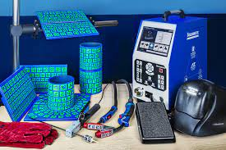
Welding Simulator Implementation
Student Engagement:
Interactive Learning:
Capitalize on the engaging and interactive nature of simulators to maintain student interest and motivation.
Realistic Simulation:
Emphasize the lifelike simulation capabilities of the equipment, creating an immersive and authentic learning experience.

Slide 8
Distance learning and zoom lectures
Advantages of ZOOM:
Accessible Anywhere:
Attendees can access lectures from any location with an internet connection, promoting flexibility and inclusivity.
Interactive Learning:
Utilize ZOOM's features for live chat, polls, and Q&A sessions to enhance engagement and interaction during theoretical lectures.
Recording and Playback:
Record lectures for future reference, allowing students to review content or catch up on missed sessions.
Real-Time Collaboration:
Facilitate real-time collaboration, enabling discussions, group activities, and instant feedback.
Cost-Effective:
Eliminate the need for physical classrooms, reducing overhead costs associated with traditional lecture settings.

Slide 9
Distance learning and zoom lectures
Implementation Process:
Training for Instructors:
Ensure instructors are proficient in using ZOOM, including features like screen sharing, breakout rooms, and interactive tools.
Student Orientation:
Conduct orientation sessions to familiarize students with the ZOOM platform, ensuring a smooth transition to virtual learning.
Technical Support:
Establish a reliable support system for technical issues, ensuring minimal disruptions during lectures.

Slide 10
Distance learning and zoom lectures
Engagement Strategies:
Visual Aids and Multimedia:
Incorporate visual aids, multimedia presentations, and virtual whiteboards to enhance the delivery of theoretical content.
Active Participation:
Encourage student participation through discussions, polls, and interactive activities to maintain a dynamic learning environment.
Guest Speakers and Industry Insights:
Leverage the virtual setting to bring in guest speakers or experts from the welding industry for insightful lectures.

Slide 11
Distance learning through moodle platform
Advantages of Moodle:
Accessibility and Flexibility:
Facilitate learning from anywhere with an internet connection, offering flexibility for students with diverse schedules.
Centralized Learning Hub:
Moodle serves as a centralized platform for course materials, assignments, and communication, streamlining the learning process.
Multimedia Integration:
Support a variety of learning materials, including videos, documents, and interactive quizzes, enhancing the richness of educational content.
Discussion Forums:
Foster student collaboration through discussion forums, promoting interaction and the exchange of ideas even in a virtual setting.
Progress Tracking:
Enable students to track their progress, grades, and completion status, fostering a sense of accountability.

Slide 12
Distance learning through moodle platform
Implementation Process:
Course Setup:
Design user-friendly courses within Moodle, ensuring a logical and organized structure for easy navigation.
Training for Instructors:
Provide comprehensive training for instructors on Moodle's features and tools to enhance their ability to deliver effective online instruction.
Student Onboarding:
Conduct orientation sessions for students to familiarize them with Moodle's interface and functionalities.

Slide 13
Distance learning through moodle platform
Interactive Learning Strategies:
Quizzes and Assessments:
Utilize Moodle's quiz features for assessments, allowing for automated grading and instant feedback.
Collaborative Projects:
Incorporate group projects and collaborative activities to promote teamwork and engagement.
Virtual Labs and Simulations:
Integrate virtual labs or simulations within Moodle to provide hands-on experience in a remote learning environment.

Slide 14
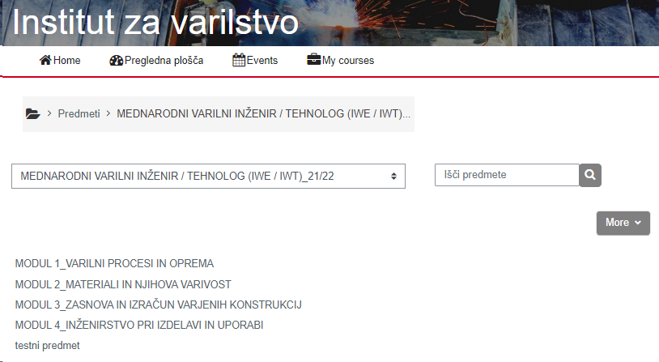
Distance learning through moodle platform

Slide 15
Recognizing Prior Learning in MIG/MAG Welder Training - Theory
Enhancements in Theory Recognition:
Implement a comprehensive assessment process to identify and evaluate theoretical knowledge acquired through prior learning.
Develop a systematic approach to assess competencies aligned with MIG/MAG welding theory.
Customized Learning Paths:
Tailor learning paths based on the results of the assessment, allowing learners to focus on areas where additional training is needed.
Provide resources and materials to bridge knowledge gaps identified during the assessment.
Digital Assessment Tools:
Integrate digital assessment tools within the theoretical training modules to efficiently evaluate and validate prior learning.
Utilize adaptive quizzes and exams to measure understanding and retention of key concepts.
Instructor Guidance:
Empower instructors to work closely with learners, providing mentorship and support to maximize the benefits of their prior learning experiences.
Encourage open communication channels for learners to discuss their prior knowledge and address any questions or concerns.

Slide 16
Recognizing Prior Learning in MIG/MAG Welder Training - Practice
Practical Assessment Framework:
Develop a robust framework for the assessment of practical skills acquired outside the formal training setting.
Incorporate real-world scenarios and projects that allow learners to showcase their practical expertise.
Workplace Experience Recognition:
Acknowledge and value work experience in relevant settings by incorporating mechanisms to recognize and credit workplace learning.
Collaborate with industry partners to validate and endorse practical competencies gained in real-world environments.
Portfolio Evaluation:
Encourage learners to create portfolios showcasing their practical work, including welding samples, projects, and documentation of their experiences.
Establish a systematic process for instructors to review and assess these portfolios for evidence of proficiency.
Supervised Practical Challenges:
Implement supervised practical challenges that allow learners to demonstrate their skills in controlled environments.
Provide opportunities for direct observation and assessment of welding techniques, safety practices, and adherence to industry standards.

Slide 17
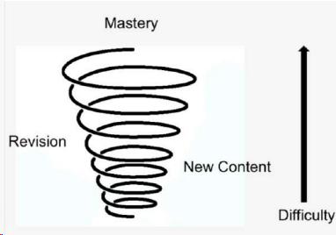
Work based learning and the brunner curve
Understanding the Bruner Curve:
Bruner Curve is a cognitive development model proposed by Jerome Bruner, emphasizing the importance of active learning and hands-on experiences in the learning process.
Bridging Theory and Practice:
work-based learning provides a bridge between theoretical concepts and practical application in MIG/MAG welding.
workplace experiences reinforce and solidify theoretical knowledge.
work-based learning enhances the retention of MIG/MAG welding theory by providing opportunities for learners to apply and test their knowledge in real-world scenarios.
work-based learning supports learners in progressing along the Bruner Curve, starting with hands-on experiences and gradually moving towards more abstract and advanced welding theories.

Slide 18
Work based learning and the brunner curve
Benefits
Enhanced Learning Retention
Real-world Application of Theoretical Concepts
Skill Development and Competency Building
Industry Relevance and Currency
Problem-Solving and Critical Thinking
Increased Motivation and Engagement
Continuous Improvement through Feedback

Slide 19
Videos as a teaching media
Evolution of Teaching Media:
the increasing role of multimedia in modern education.
the integration of videos is a powerful teaching tool in MIG/MAG welding training.
Visual Learning Impact:
the impact of visual learning on information retention.
the effectiveness of videos in conveying complex MIG/MAG welding processes and techniques.

Slide 20
Videos as a teaching media
Demonstration of Techniques:
Explanation: Videos allow for detailed demonstrations of MIG/MAG welding techniques, providing a visual guide for learners.
Benefit: Improved understanding as learners can observe correct procedures and nuances in real-time or in slow motion.
Access to Real-world Examples:
Explanation: Videos can showcase real-world welding applications, demonstrating how theoretical concepts are applied in practice.
Benefit: Enhances the connection between theory and practical application, making learning more tangible.
Remote Learning Flexibility:
Explanation: Videos enable remote learning, allowing students to access instructional content from anywhere.
Benefit: Increases flexibility in training, catering to diverse schedules and geographical locations.
Repetition for Mastery:
Explanation: Learners can replay videos for repeated viewing, reinforcing concepts and facilitating mastery.
Benefit: Encourages self-paced learning and accommodates varied learning speeds.

Slide 21
Videos as a teaching media
Integration Strategies:
Curriculum Integration:
Explanation: Integrate videos seamlessly into the MIG/MAG welding training curriculum.
Benefit: Creates a blended learning approach that combines theoretical understanding with practical visual examples.
Creation of Customized Content:
Explanation: Develop customized videos to address specific training needs and scenarios.
Benefit: Tailors content to the unique requirements of the training program, ensuring relevance to learners.
Interactive Elements:
Explanation: Incorporate interactive elements within videos, such as quizzes or pause-and-reflect moments.
Benefit: Engages learners actively, promoting interaction and self-assessment

Slide 22
Overview

Slide 23
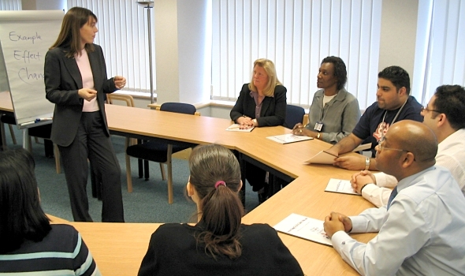
Improving classical classroom lectures
Engagement Strategies:
Interactive Learning Techniques:
Explanation: Incorporate interactive elements such as discussions, Q&A sessions, and group activities.
Benefit: Promotes active engagement, fostering a collaborative learning environment.
Visual Aids and Multimedia Integration:
Explanation: Enhance lectures with visual aids, multimedia presentations, and diagrams.
Benefit: Appeals to visual learners and reinforces theoretical concepts through diverse mediums.
Real-world Applications:
Explanation: Relate theoretical concepts to real-world MIG/MAG welding applications.
Benefit: Provides context and relevance, improving understanding and retention.

Slide 24
Improving classical classroom lectures
Technology Integration:
Utilizing Online Resources:
Explanation: Incorporate online resources, tutorials, and e-learning modules.
Benefit: Expands learning opportunities beyond the classroom, promoting self-directed learning.
Virtual Welding Simulators:
Explanation: Integrate virtual welding simulators into lectures for a dynamic, risk-free practical experience.
Benefit: Enhances engagement and skill development in a controlled environment.

Slide 25
Improving classical classroom lectures
Continuous Improvement Strategies:
Student Feedback Mechanisms:
Explanation: Implement regular feedback mechanisms to gauge student understanding and satisfaction.
Benefit: Provides insights for refining lecture delivery and adapting to student needs.
Professional Development for Instructors:
Explanation: Encourage ongoing professional development for instructors, including workshops and training.
Benefit: Ensures instructors are equipped with the latest teaching methodologies and industry insights.

Slide 26
Questions?

Slide 27
Thank you for your attention!

