Slide 1
Modernizing the MIG/MAG welding course

Slide 2
Program
Who we are
Flowchart
EWF
SDVT
IZV
DCUSM
EA / SA
VARcert
MIG/MAG Course

Slide 3
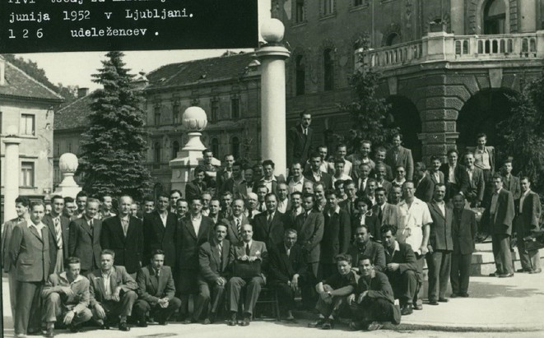
Presentation of IZV

Slide 4
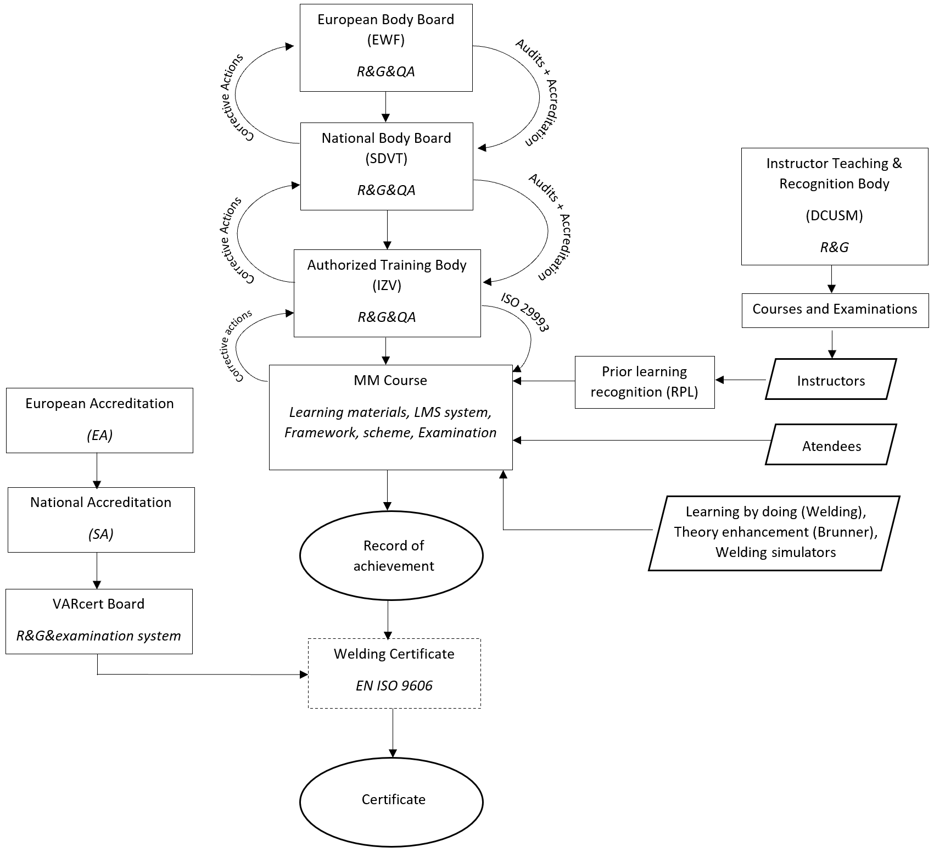

Slide 5
EWF

Slide 6
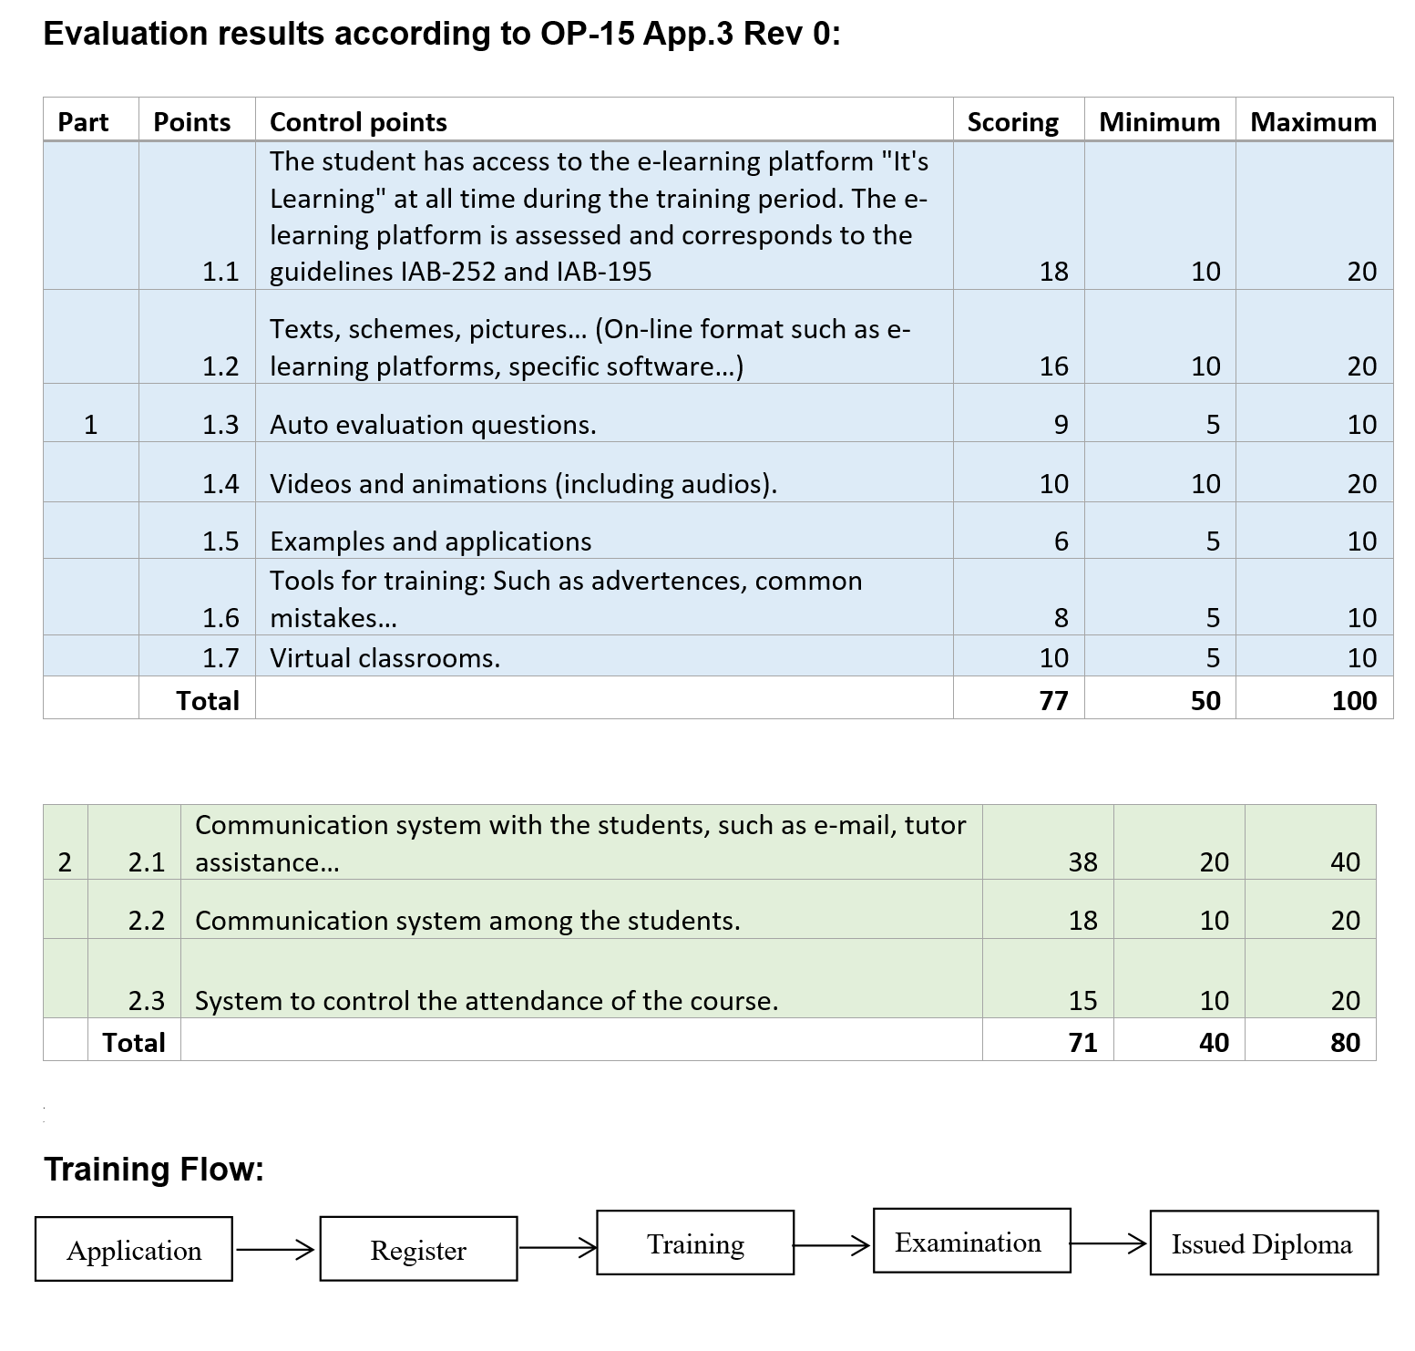

Slide 7
SDVT
https://drustvo-sdvt.si/
Trello
ANB

Slide 8
IZV
ATB of SDVT
Acrreditation according to ISO 17024 SA/EA
Notified body 2042
Education center
Two welding schools
Welding coordinator education
NDT personnel education and certification

Slide 9
EA / SA
Accreditation of services and certification systems
Internationally recognized
SA
EA

Slide 10
VARcert
Certification body of IZV
Five independant experts + five industrial experts
Biggest certification body for the certification of welders in Slovenia

Slide 11
Modernizing the MIG/MAG course

